Slide 1
The role of imaging in Foreign body aspiration diagnosis
Azar. dastranji
assistant Professor .Tabriz University of medical Sciences

Slide 2
The initial diagnostic evaluation of patients with suspected FB aspiration includes:
Postero –anterior radiograph
Lateral chest radiograph
Neck if needed

Slide 3
. The visibility of the aspirated FB depends on:
Its radio-opacity
Size
Anatomical position in the airway
The patient’s body habitus.

Slide 4
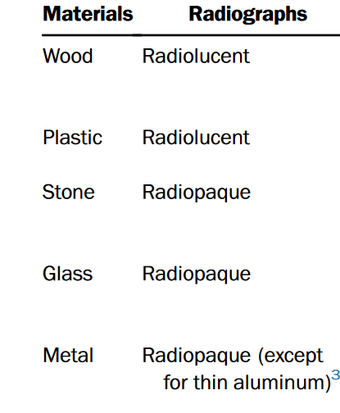
It is estimated that only around 26% of the aspirated FBs are radio-opaque and visible on chest radiographs.

Slide 5
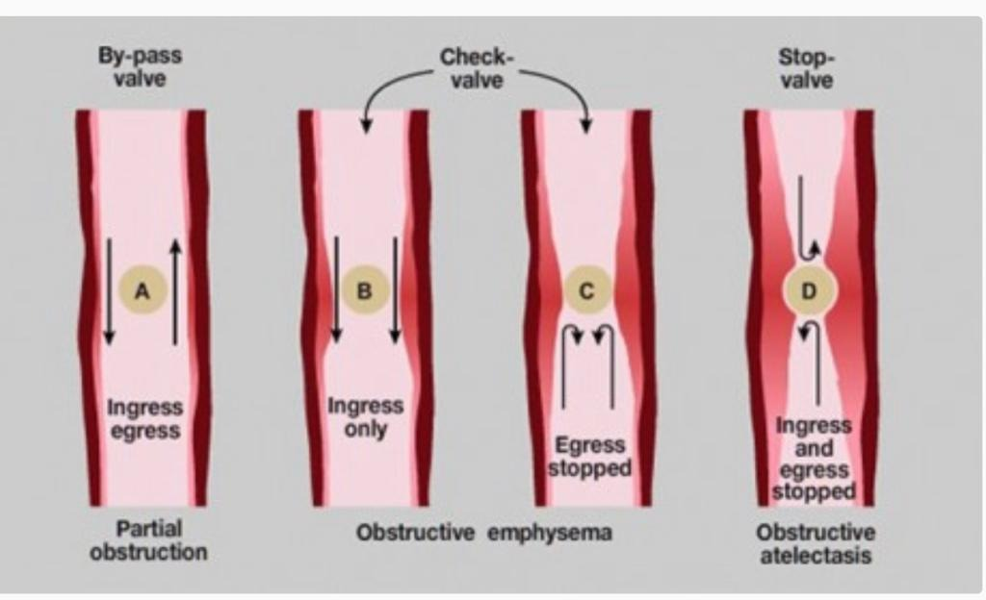

Slide 6
Indirect radiological signs were as follows:
36.5% of the examinations showed a shift of the mediastinum
35.3% showed air-trapping on the affected side of the lung caused by the FBs (obstructive emphysema)
23.6% showed the signs of pneumonia.
Nearly one-third (32%) of the patients with bronchial FBs exhibited normal X-ray findings.

Slide 7
Indirect signs of FB aspiration seen on chest radiography include :
Hyper-lucency suggesting air trapping
Atelectasis
Consolidation
Mediastinal shift

Slide 8
Blanco Ramos et al. reported the incidence of these radiological findings from various case series as:
Consolidation (43%)
Atelectasis (15%)
Bronchiectasis (5%)
Though absence of these does not exclude FB aspiration.

Slide 9
The sensitivity of chest radiograph has been documented as 67.9% and the specificity has been seen to be 71.4%.

Slide 10
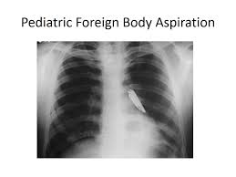

Slide 11
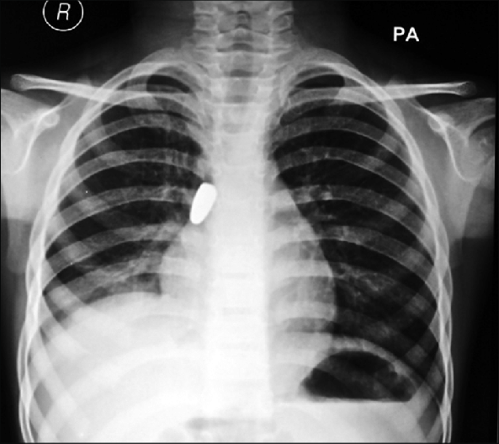

Slide 14
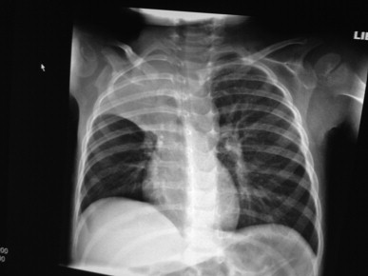

Slide 15
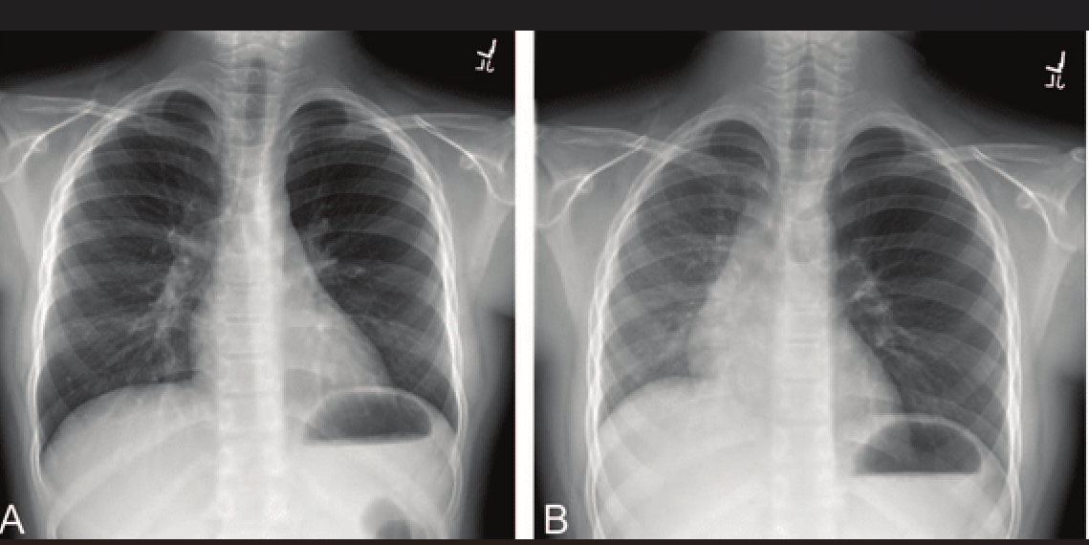

Slide 16
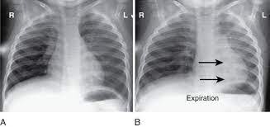

Slide 17
Lateral decubitus chest radiography, fluoroscopy, or both may help in diagnosing foreign body aspiration in patients who are unable to cooperate with inspiratory and expiratory CXRs, such as young pediatric patients under 5 years.
Fluoroscopy provides real time images and is rarely used for FB evaluation.

Slide 18
Low-dose chest CT is a remarkably effective and consistent tool for diagnosing FBA in children, with a sensitivity of 100% and a specificity of 98%.
The FB is visible on CT in 62% cases and helps in identifying concomitant or indicative consolidation, atelectasis, pleural effusion and bronchial wall abnormalities .

Slide 19
Chest CT scan Finding:
Endobronchial foreign body
Volume loss
Hyperlucency with air trapping
Bronchiectasis
Pneumonia

Slide 20
Its use should be more widely adopted, as it can be performed quickly with minimal radiation exposure and can prevent unnecessary bronchoscopies and also to examine symptomatic patients after bronchoscopy for
residual foreign body.

Slide 21
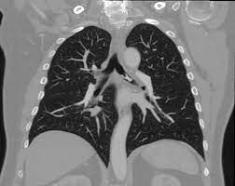

Slide 22
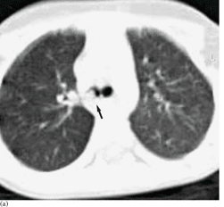

Slide 23
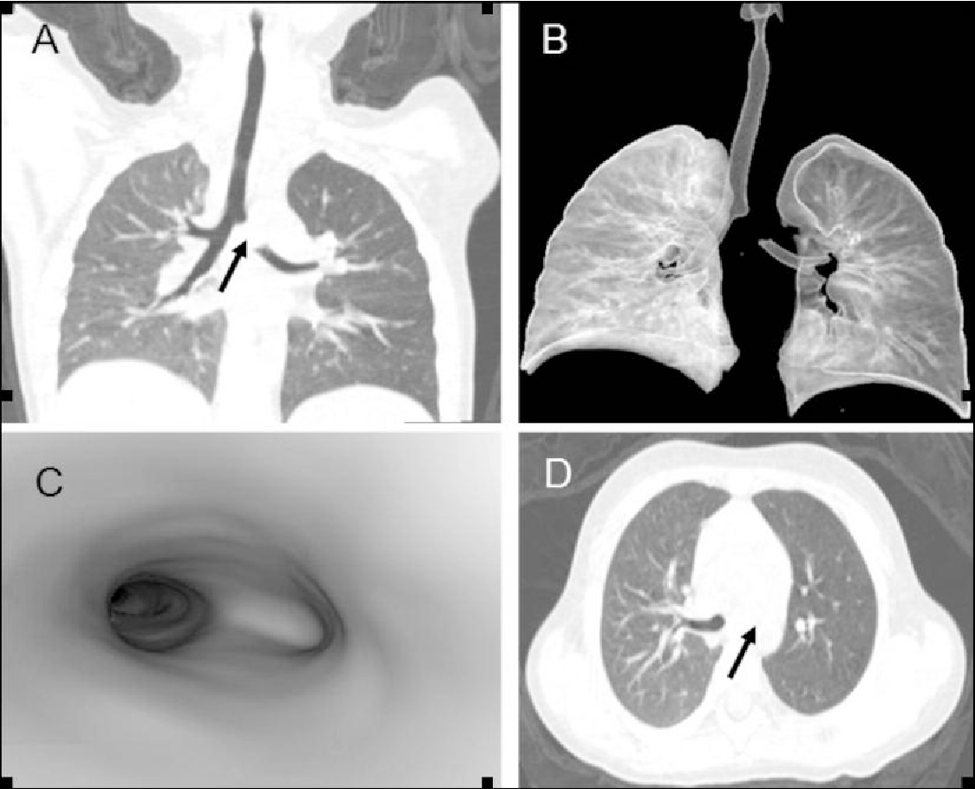

Slide 24
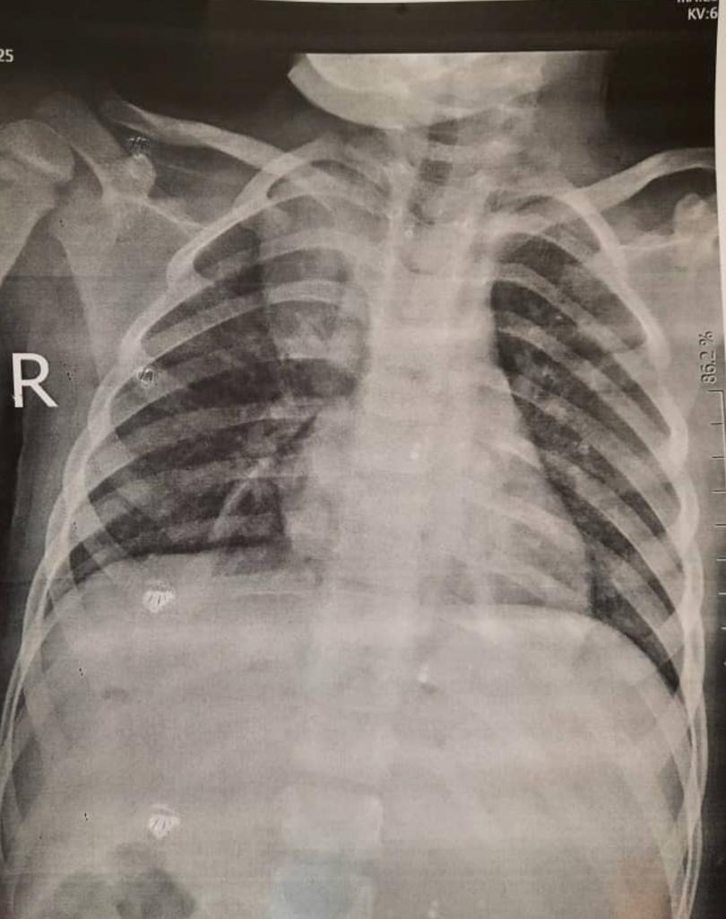

Slide 25
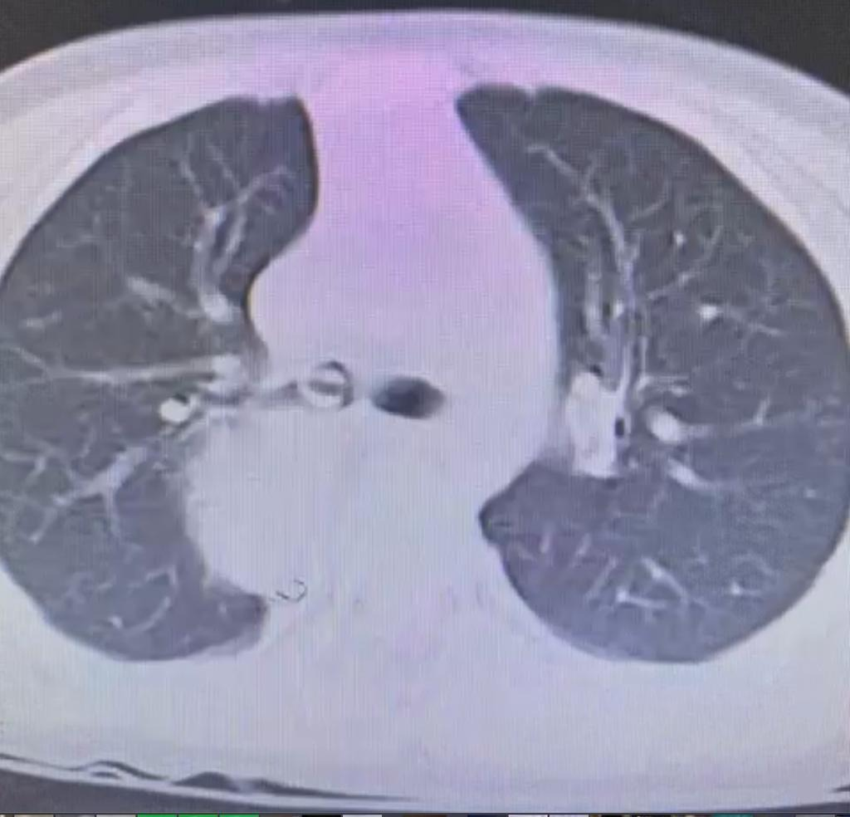

Slide 26
